Slide 1
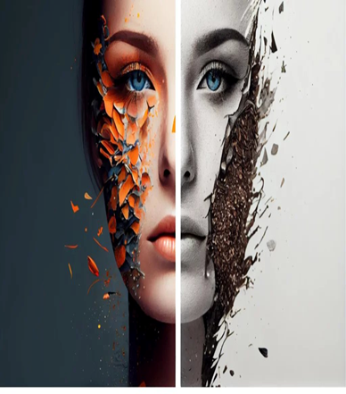
TOONIFY
AI Cartoon Effect Generator
Mentor: Thavayee Annadurai
Coordinator: Anantha Lakshmi

Slide 2
PROBLEM STATEMENT
The Problem
Toonify Solves This
► Expensive Tools
Photoshop & similar tools are costly
and not accessible to everyone.
► One-Click Web App
Instant browser-based tool — no install,
no expertise required.
► Requires Design Skills
Steep learning curve blocks non-designers
from creating any cartoon effects.
► AI-Powered Effects
Smart AI applies cartoon & sketch effects
automatically with zero manual effort.
► Slow Bulk Processing
Converting many images or videos manually
takes hours with no automation support.
► Images & Videos in One Platform
Handles both photos and full videos with
frame-by-frame cartoon transformation.

Slide 3






TECH STACK
Python 3.x
OpenCV
▶ Core backend language for all processing logic
▶ Image & video processing — filters, edges, bilateral
Streamlit
HTML / CSS
▶ Web UI built with Streamlit, HTML & JS for upload, preview & download
▶ Structured UI layout, styling & responsive design elements
React
SQLite
► Component-based UI library for dynamic web apps
► Lightweight database for user data, credits & session storage

Slide 4




CHALLENGES & SOLUTIONS
Challenges
Solutions
1
Real-Time Video Processing Lag
Frame Batch Processing +MoviePy
1
Heavy CPU load during video rendering causes frame drops and delay
Frames are grouped and processed together using MoviePy, reducing lag
Inconsistent Quality on Varied Images
Adaptive Preprocessing Pipeline
2
2
Smart preprocessing normalizes brightness & contrast before applying effects
Different resolutions & lighting conditions degrade cartoon output quality

Slide 5
KEY ACHIEVEMENTS
🎨 Cartoon Styles
🎥 Video Support
Classic Cartoon, Pencil Sketch & Color effects with adjustable intensity
Full video transformation, frame-by-frame cartoon rendering via MoviePy
🌐 Web App
🌓 5+ Filters & Frames
Streamlit UI with side-by-side original vs. cartoon image comparison
B&W, Infrared, Moon, X-Pro II filters + decorative frame overlays
🔒 Secure Auth
⚡ AI-Powered
User login + 1 credit per download via integrated payment gateway
OpenCV + bilateral filters for smart, automatic cartoon generation

Slide 6
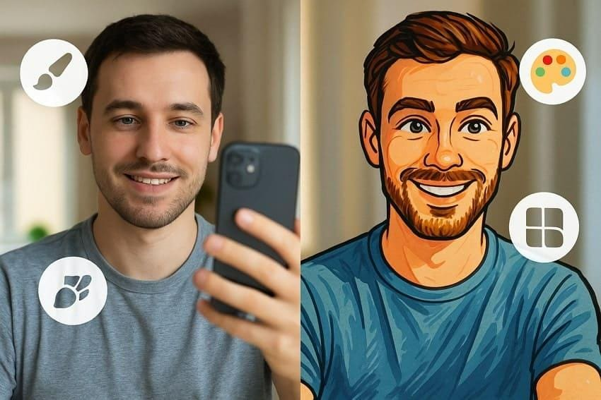
FUTURE SCOPE
01
GAN-Based Style Transfer
▶ Integrate CartoonGAN / AnimeGAN for photorealistic cartoon styles beyond OpenCV filters
02
Mobile Application
▶ React Native / Flutter app for real-time on-device cartoon effects using mobile GPU
03
Live Webcam Filter
▶ Real-time cartoon filter on live webcam stream for interactive demos & content creation

Slide 7
CONCLUSION
Toonify delivers a complete end-to-end AI-powered platform transforming both images and videos into stunning cartoon styles. Built with OpenCV and Streamlit, it makes creative cartoon effects accessible to everyone — from artists and designers to everyday users.

Slide 8
THANK YOU

